Slide 1

Integration Testing
Nazirul Hasan
Lecturer
CSE, KUET

Slide 2
What is Integration Testing?
Integration testing is a type of software testing where components of the software are gradually integrated and then tested as a unified group.
Usually, these components are already working well individually, but they may break when integrated with other components. With integration testing, testers want to find defects that surface due to code conflicts between software modules when they are integrated with each other.

Slide 3
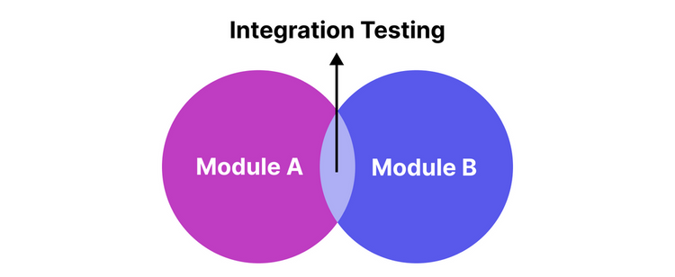
Why is Integration Testing Important?
Software is often built from many individual software components or modules. These modules may pass unit testing and work perfectly fine individually, yet collapse when put together, for various reasons:

Slide 4
Why is Integration Testing Important?
Inconsistent code logic: They are coded by different programmers whose logic and approach to development differ from each other, so when integrated, the modules cause functional or usability issues. Integration testing ensures that the code behind these components is aligned, resulting in a working application.

Slide 5
Why is Integration Testing Important?
Shifting requirements: Clients change their requirements frequently. Modifying the code of 1 module to adapt to new requirements sometimes means changing its code logic entirely, which affects the entire application. These changes are not always reflected in unit testing, hence the need for integration testing to uncover the missing defects.

Slide 6
Why is Integration Testing Important?
Erroneous Data: Data can change when transferred across modules. If not properly formatted when transferring, the data can’t be read and processed, resulting in bugs. Integration testing is required to pinpoint where the issue lies for troubleshooting.

Slide 7
Why is Integration Testing Important?
Third-party services and API integrations: Since data can change when transferred, API and third-party services may receive false input and generate false responses. Integration testing ensures that these integrations can communicate well with each other.

Slide 8
Why is Integration Testing Important?
Inadequate exception handling: Developers usually account for exceptions in their code, but sometimes they can’t fully see all of the exception scenarios until the modules are pieced together. Integration testing allows them to recognize those missing exception scenarios and make revisions.

Slide 9
Why is Integration Testing Important?
External Hardware Interfaces: Bugs can also arise when there is software-hardware incompatibility, which can easily be found with proper integration testing.

Slide 10
Types Of Integration Testing
Big Bang Approach
Incremental Approach
Incremental Approach is carried out by 3 different methods:
Bottom-up approach
Top-down approach
Sandwich approach

Slide 11
Big Bang Integration Testing
Big Bang Integration testing is an integration testing approach in which all modules are integrated and tested at once, as a singular entity. The integration process is not carried out until all components have been successfully unit tested.

Slide 12
Big Bang Integration Testing: Advantages
Suitable for simple and small-sized systems with a low level of dependency among software components
Little to no planning beforehand is required
Easy to set up since all modules are integrated simultaneously
Management and coordination efforts are minimized since there is only one major testing phase

Slide 13
Big Bang Integration Testing: Disadvantages
Costly and time-consuming for large systems with a huge number of units as testers have to wait until all modules have been developed to start testing
Waiting for all modules to be developed before testing also means late defect detection
Hard to isolate and pinpoint bugs in specific modules
Hard to debug due to the complexity of multiple integrated modules

Slide 14
Big Bang Integration Testing: Best Practices
Clearly define the interactions between each unit/function before testing to minimize missing defects
01
Perform extensive logging for more accurate fault localization
02
Perform Big Bang testing for simple applications
03

Slide 15
Incremental Integration Testing
Incremental integration testing is an approach in which 2 or more modules with closely related logic and functionality are grouped and tested first, then gradually move on to other groups of modules, instead of testing everything at once.

Slide 16
Incremental Integration Testing: Advantages
Earlier defect detection compared to Big Bang testing since the modules are integrated and tested as soon as they are developed. QA teams don't have to wait until all modules are available to begin testing.
Easier fault localization since the modules are tested in relatively small groups.
The strategic nature of incremental integration testing can be leveraged in project management. For example, QA managers can choose which module to test first based on urgency, priority, or resource availability.
The risk of encountering catastrophic failures is also significantly reduced since issues are addressed early on from the root.

Slide 17
Incremental Integration Testing: Disadvantages
Require thorough planning beforehand
The total number of tests to perform can be huge depending on the scale of the project, requiring significant organizational resources
Coordinating a large integration testing project with this approach may be complex
Require a complete definition and logic of the system before it can be broken down into small units
In earlier stages of the project, certain system functionalities may not yet be available, leading to a dependence on stubs and drivers (which are essentially mock components that will be used as substitutes for actual components)
The lack of system functionalities in earlier stages, if not carefully documented, may even lead to system “blindspots” later down the road

Slide 18
Bottom-up approach
With the bottom-up approach, testers start with individual modules at the lowest level, then gradually move to higher-level modules, hence the term “bottom-up”.

Slide 19
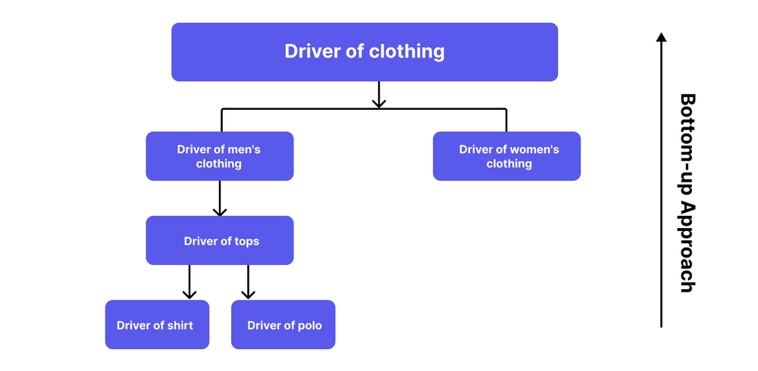
Bottom-up approach

Slide 20
Top-down approach
With the top-down approach, testers start with the highest-level modules, then gradually move to lower-level modules, hence the term “top-down”.

Slide 21
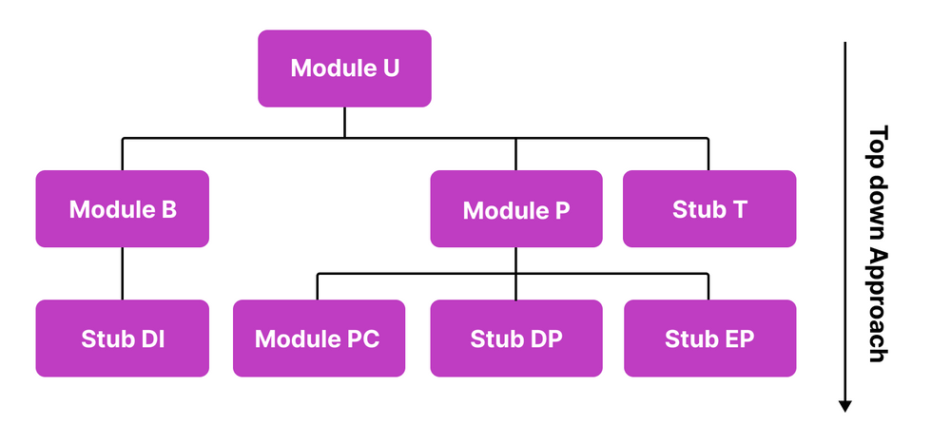
Top-down approach

Slide 22
Top-down approach
The diagram illustrates the modules required for a ride-hailing application:
Module A: User Authentication
Module B: Ride Booking
Stub DI: Driver Information
Module P: Payment Processing
Module PC: Payment-by-cash/ PC
Stub DP: Debit Card/Credit Card Payment aka DP (Yet to be developed)
Stub EP: E-Payment/ EP (Yet to be developed)
Module T: Ride Tracking

Slide 23
When to use Bottom-up?
Complexity is primarily found in lower-level modules
The team follows incremental development (which involves developing lower-level components first before moving to higher-level modules)
Defect localization is a crucial aspect of the project since the granularity of the bottom-up approach provides more exact bug isolation
Higher-level modules are still under development or likely to change frequently

Slide 24
When to use Top-down?
The critical functionalities are primarily concentrated in the higher-level components
01
When it's crucial to simulate real-world scenarios and user interactions, top-down testing provides a more holistic view of the system's behavior early on.
02
Lower-level modules are more well-defined, stable, and unlikely to change significantly
03
Top-down testing allows for faster validation of user-facing features, enabling early prototypes for user feedback.

Slide 25
Hybrid Approach (Sandwich Approach)
Sandwich Testing (also known as Hybrid Integration Testing) is an approach in which testers employ both top-down and bottom-up testing simultaneously.

Slide 26
Hybrid Approach: Advantages
QA teams can tailor their integration testing activities based on project requirements, combining the strengths of different methods.
More flexibility in terms of using resources
Ensuring that both the low-level and high-level software components are verified at the same time

Slide 27
Hybrid Approach: Disadvantages
Complex and requires careful planning and coordination to decide which modules to test using each method
Effective communication among team members is crucial to ensure consistency and proper tracking of issues
Teams may find it challenging to switch between different integration strategies

Slide 28
A Test Case For Integration Testing
In the case of a banking application, these are the common integration testing cases:
Verifying if the balance of the user is deducted by the correct amount that they sent and if the balance of the recipient increased by the correct amount, after accounting for fees.
Verify that transactions (e.g., deposits, withdrawals) accurately update the account balances and reflect in the transaction history.

Slide 29
A Test Case For Integration Testing
In the case of a banking application, these are the common integration testing cases:
Verify that account statements are generated correctly and display the transaction history and interest earned.
Verify that data consistency is maintained, and transactions do not lead to unexpected conflicts or errors.

Slide 30
Integration Testing Best Practices
Ensure that all modules have been unit tested before moving to the integration phase so that the integration test results are reliable
Develop a comprehensive test plan and strategy that outlines the scope, objectives, test cases, and resources required for integration testing.
Automate repetitive and complex test cases to improve testing efficiency and maintain test consistency across different test runs.

Slide 31
Integration Testing Best Practices
Validate the input test data for higher test reliability
Perform regression testing after each integration to ensure that new changes do not impact previously integrated components adversely.

Slide 32

Thank You!

